Slide 1

A PIOTIX Technologies Ltd.
CHANGING APIPLATFORM
One extraction technology, numerous industry applications
August 2022

Slide 2

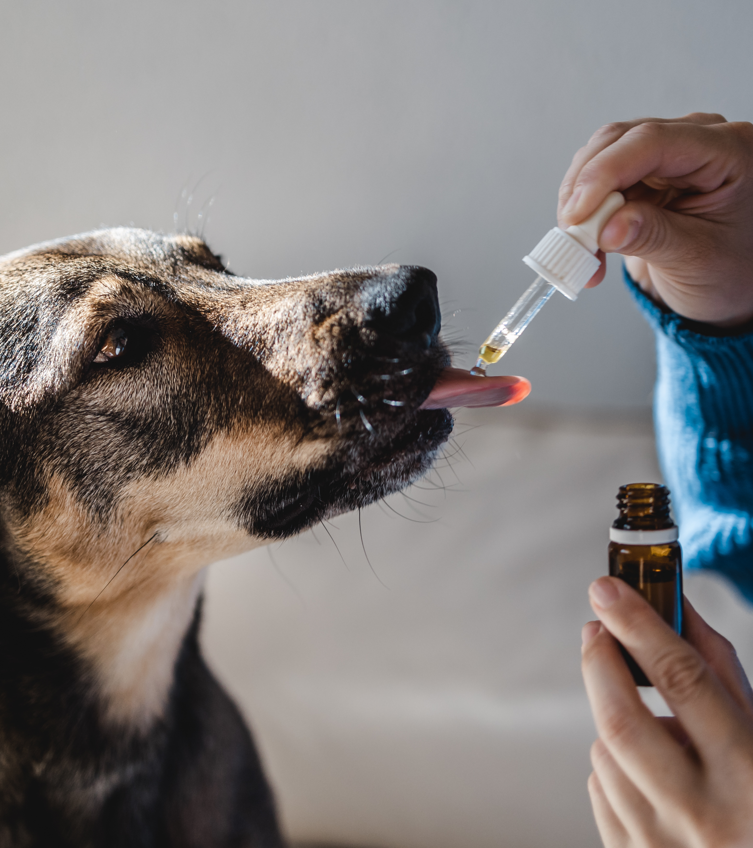
Apiotix Technologies
One technology, numerous applications
Our proprietary technology enables superior extraction from various natural sources, with potential applications in:
Cosmetics
Animal Health
Human Health
Plant Health
Food

Slide 3
What is exactly our technology?
WO2020169425 - LIQUID PROPOLIS EXTRACT, ITS FORMULATION AND USE THEREOF
First pharmaceutically standardized non-alcoholic propolis extract
Suitable for large-scale production
The extract is characterized by standardized content of p-coumaric acid (1), trans-ferulic acid (2), caffeic acid (3), and CAPE (4).
It is used as an active ingredient in manufacturing pharmaceutical, cosmetic, veterinary, agrochemical, or functional food products
No use of solid and aggressive solvents like alcohol
Chemoselective extraction of bioactive molecules with the help of added emulsifier (lecithin)

Slide 4
What is exactly our technology?
The technical problem that is solved:
(i) a non-alcoholic liquid propolis extract, which would be characterized by high and standardized content of phenolic propolis acids, para-coumaric acid (1), trans-ferulic acid (2), caffeic acid (3) and 2-phenylethyl ester of caffeic acid, 2- phenethyl 3 , 4-dihydroxy- trans-cinnamate (4; CAPE), for which several beneficial pharmacological activities are known, on both human and animal organisms;
(ii) the process for its production;
(iii) use for the production of pharmaceutical, cosmetic, veterinary, agrochemical, or food products with known, standardized content of propolis active substances 1-4; and especially,
(iv) a pharmaceutical composition based on the mentioned propolis extract, which would be effective in the treatment of inflammatory and infective diseases, as well as diseases and conditions where the antioxidative, anti-inflammatory, and immunomodulatory activity of particular propolis active substances, play an important role in the etiology of their incidence, as suggested by certain references in the state of the art.

Slide 5
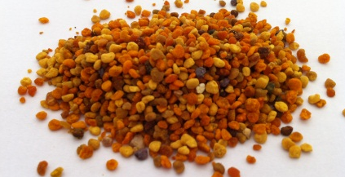
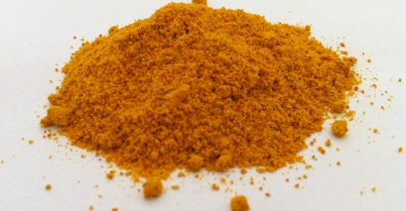
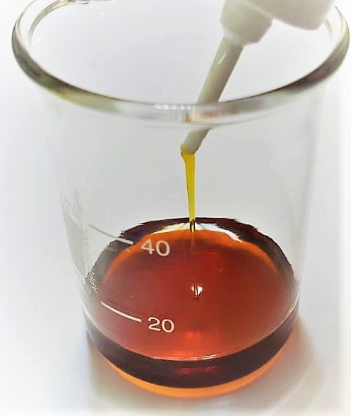
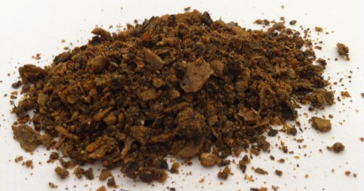
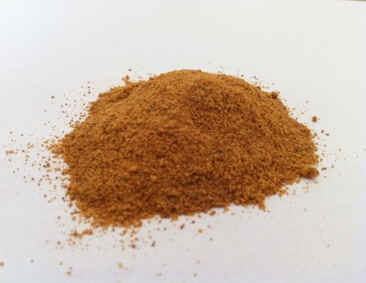
What is exactly our technology?
Our products are derived from bee products via a standardized extraction & purification process
Raw products
Intermediate product
The extract
Key takeaways:
Liquid extract with standardized content of bioactive compounds
Broad spectrum antimicrobial efficacy
Efficacy against multidrug-resistant pathogens & biofilm
Potent antioxidant effect
Alternative to antibiotics with minimum risk of resistance development
Potential of translation to human medicine
Pollen
Propolis
Collection of raw material – physical separation – chemical purification – quality control

Slide 6
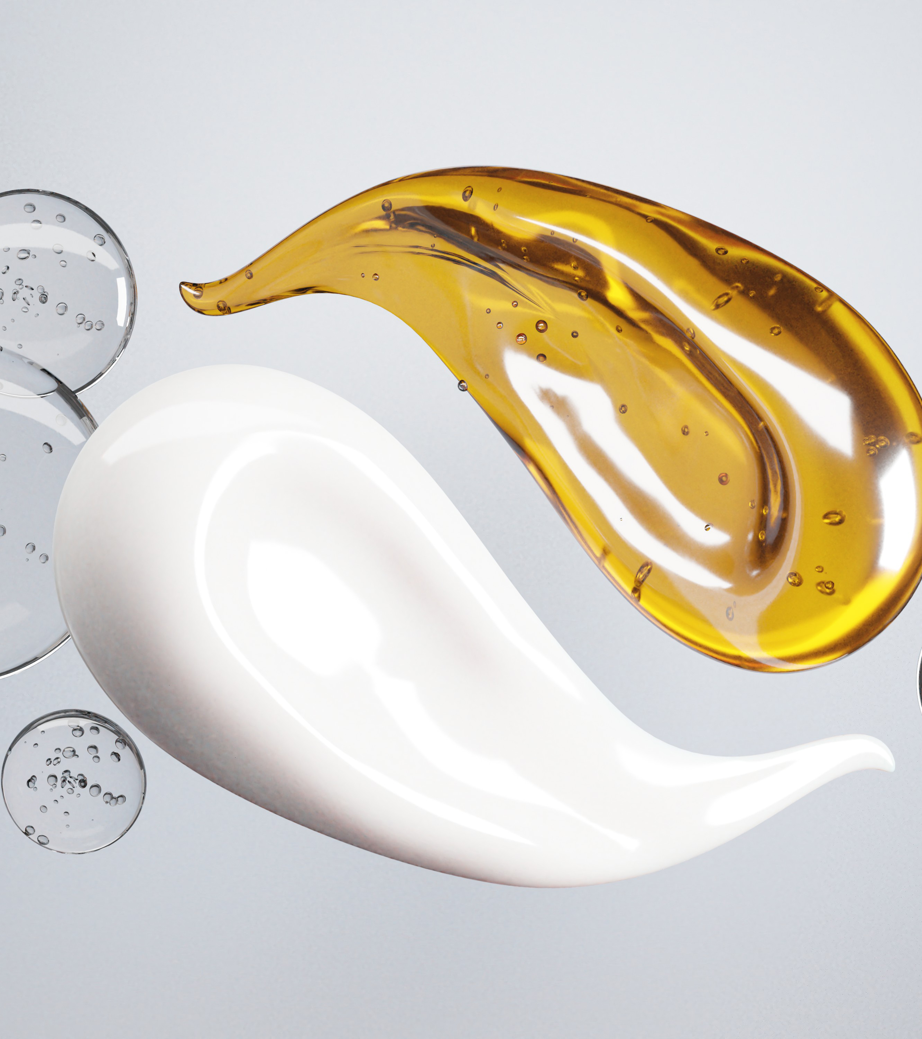
Cosmetics
Natural antioxidant to prevent skin damage & ageing
Our extracts can be easily integrated into various cosmetic formulations: creams, gels, ointments, and lotions.
Easy mixing with all kinds of bases and solvents
A natural preservative and antioxidant for increased product stability
Proven to be non-toxic on keratinocytes

Slide 7
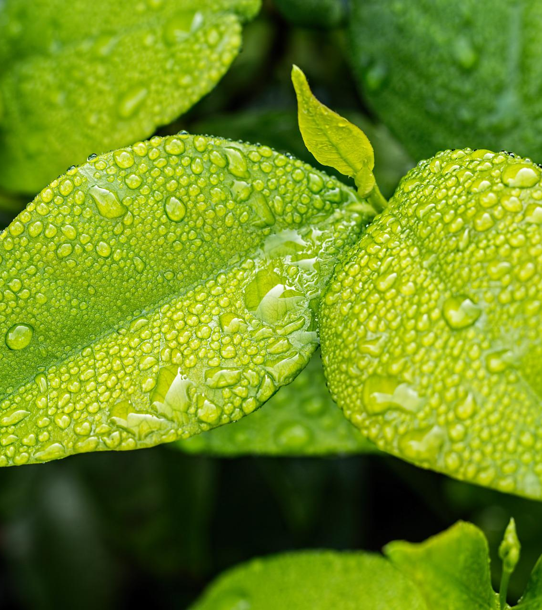
Skin care
Natural antioxidant to prevent skin damage & ageing
Potential applications:
Anti-age cosmetics: as an antioxidant and regenerative principle
For dry and damaged skin: as an anti-inflammatory
Anti-acne formulations
For hair loss: stimulates the hair growth by inducing hair keratinocyte proliferation

Slide 8
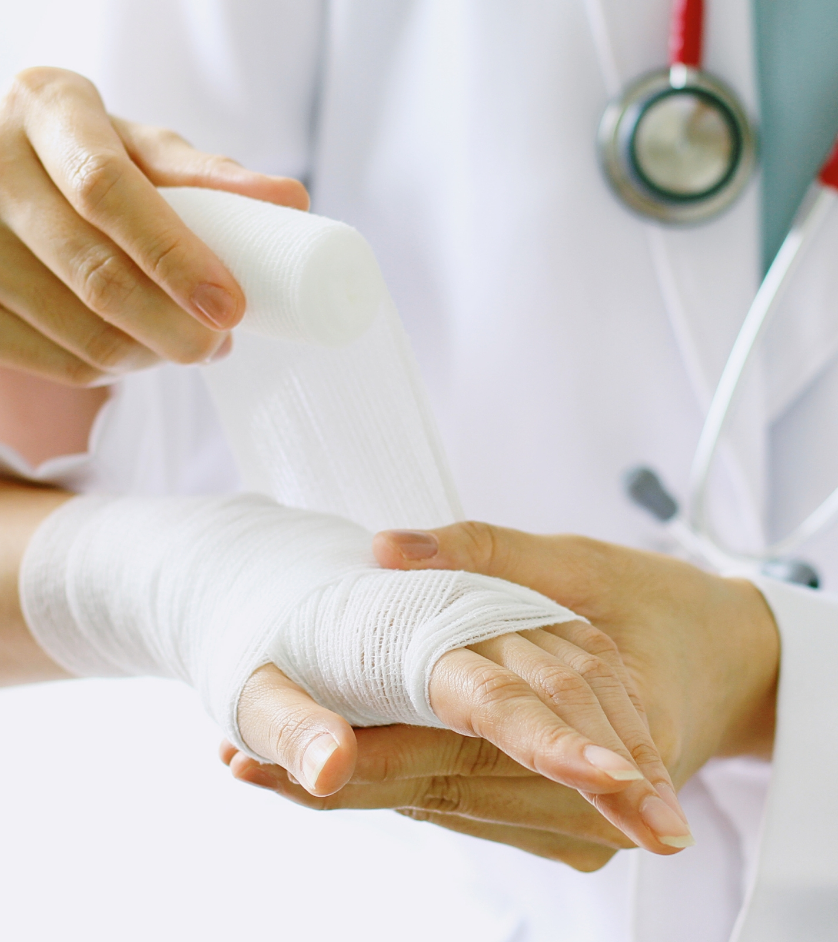
Human Health
Natural antimicrobial and anti-inflammatory agent
Wound healing
Antimicrobial Urinary Catheter Coating Agent
Topical anti-inflammatory agent:
Gingivitis/periodontitis
Sore throat

Slide 9
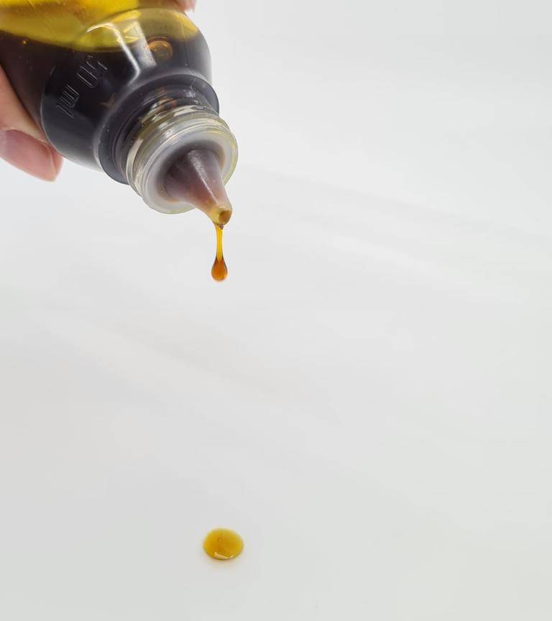
Wound Healing
Antimicrobial and regenerative activity
Our standardized propolis extract (SPE) can be integrated into various dosage forms for burn & wound care:
Wound dressings: hydrogels, hydrocolloids, foams, films, alginates, composites
Wound ointments, creams, and gels
Wound wash

Slide 10
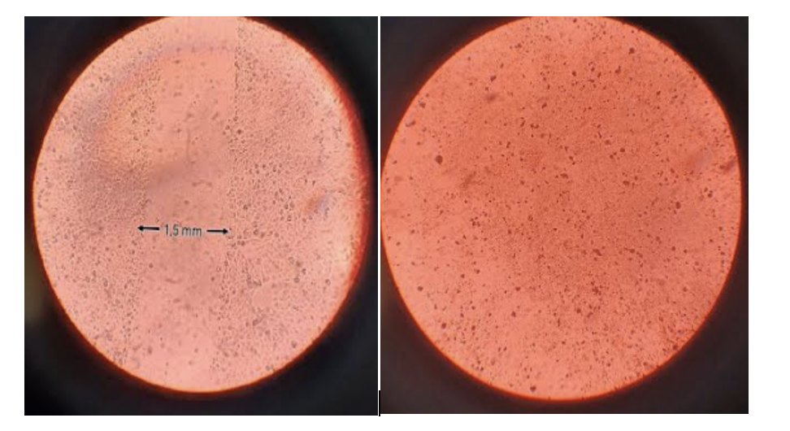
Wound Healing
In vitro assay
The scratch test assay:
On the left, the first day after the damage. On the right, the second day after application of our 1% extract

Slide 11
Wound Healing
In vivo
Numerous examples from clinics, like the dog with severe burns
The period between the left and the right picture is 3-4 weeks

Slide 12
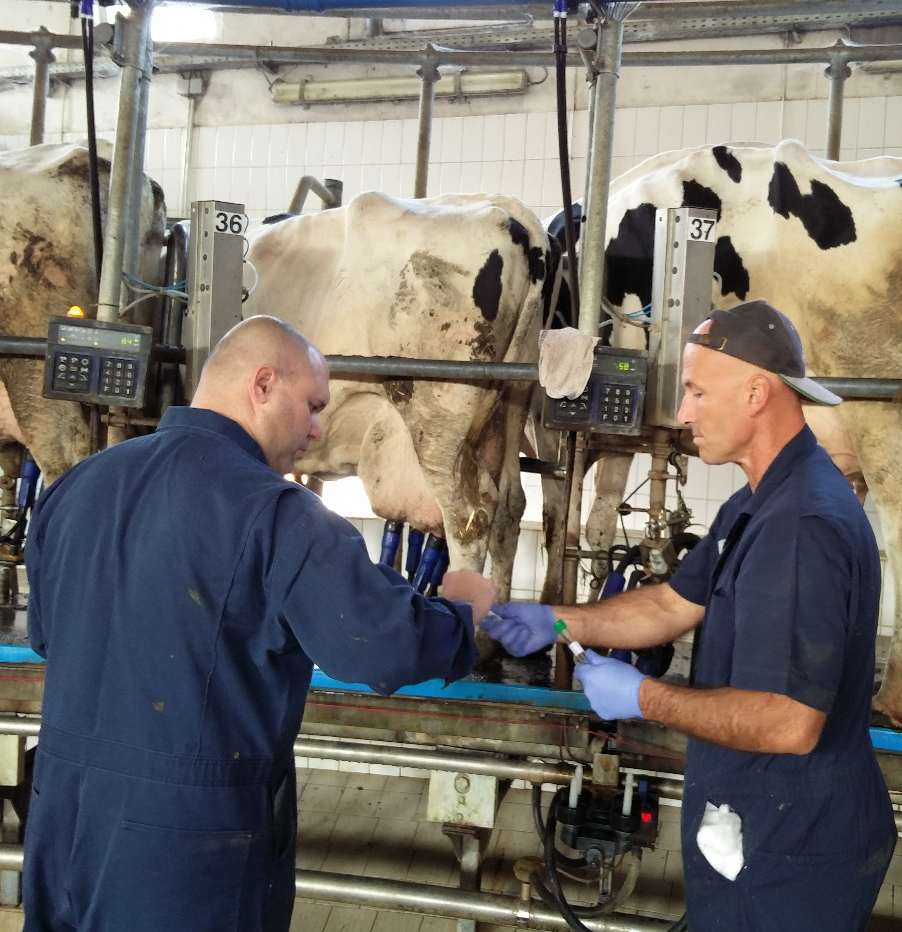
Animal Health
Fighting antimicrobial resistance, improving animal welfare
Mastitis
Wound healing
Periodontitis/Gingivitis
ApiWater - cleaner water, better growth performance
Feed supplementation - liquid and powder formulations of honey bee-based products

Slide 13
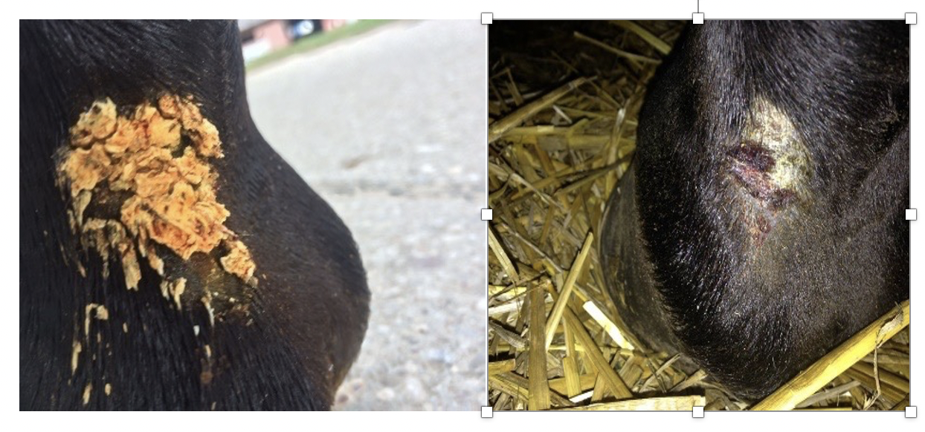
Wound healing
Clinical evidence
Our extract was used in wound healing case studies in animals. It improved the impaired healing of wounds in horses and many companion animals.
It was tested for tolerance and safety on sensitive cow udder tissue.
MTT tests showed that it is not cytotoxic
Figure 2. On the left: wound on the horse's front leg after 10 days of unsuccessful treatment with the combination of silver nitrate, iodine, and antibiotic. On the right: wound 72 h after propolis extract application (With the courtesy of Prof. Nikica Prvanović Babić, Ph.D., DVM)

Slide 14
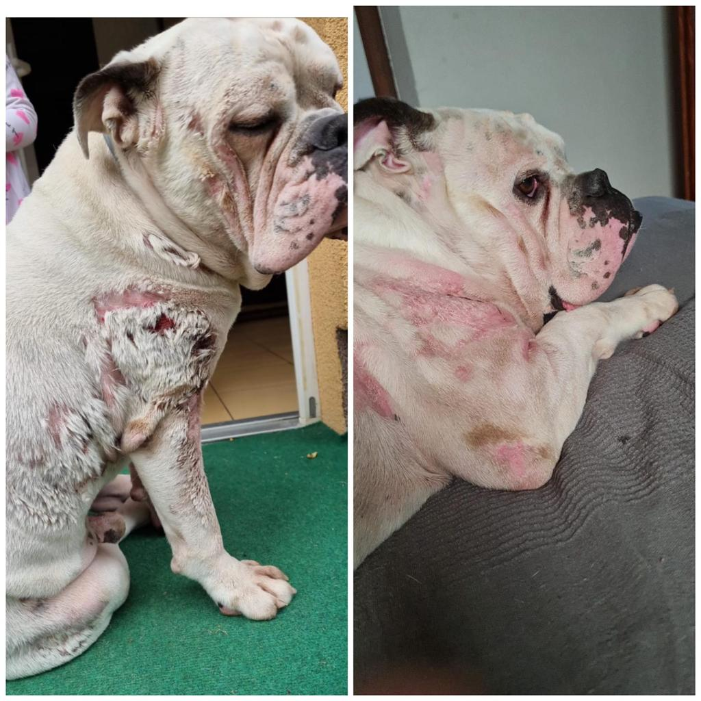
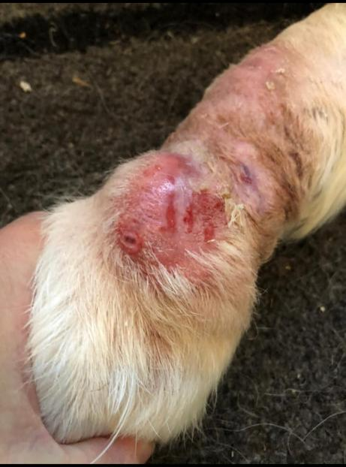
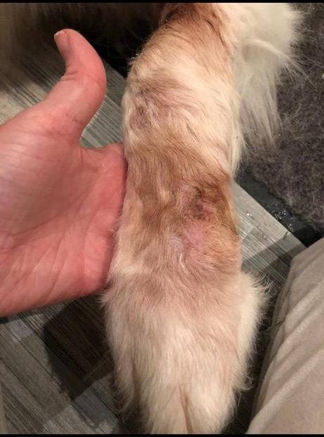
Figure 4. On the left: hot spot on dog paw. On the right: after treatment with our extract ointment.
Figure 3. On the left: a dog with second-degree burns from the fire. On the right: after treatment with our extract ointment.

Slide 15

Plant Health
For safe food and a healthy environment
Our extracts can be used for crop protection in organic agriculture
Alternative to pesticides
Added value to the final organic product
Synergy with other crop protection agents

Slide 16
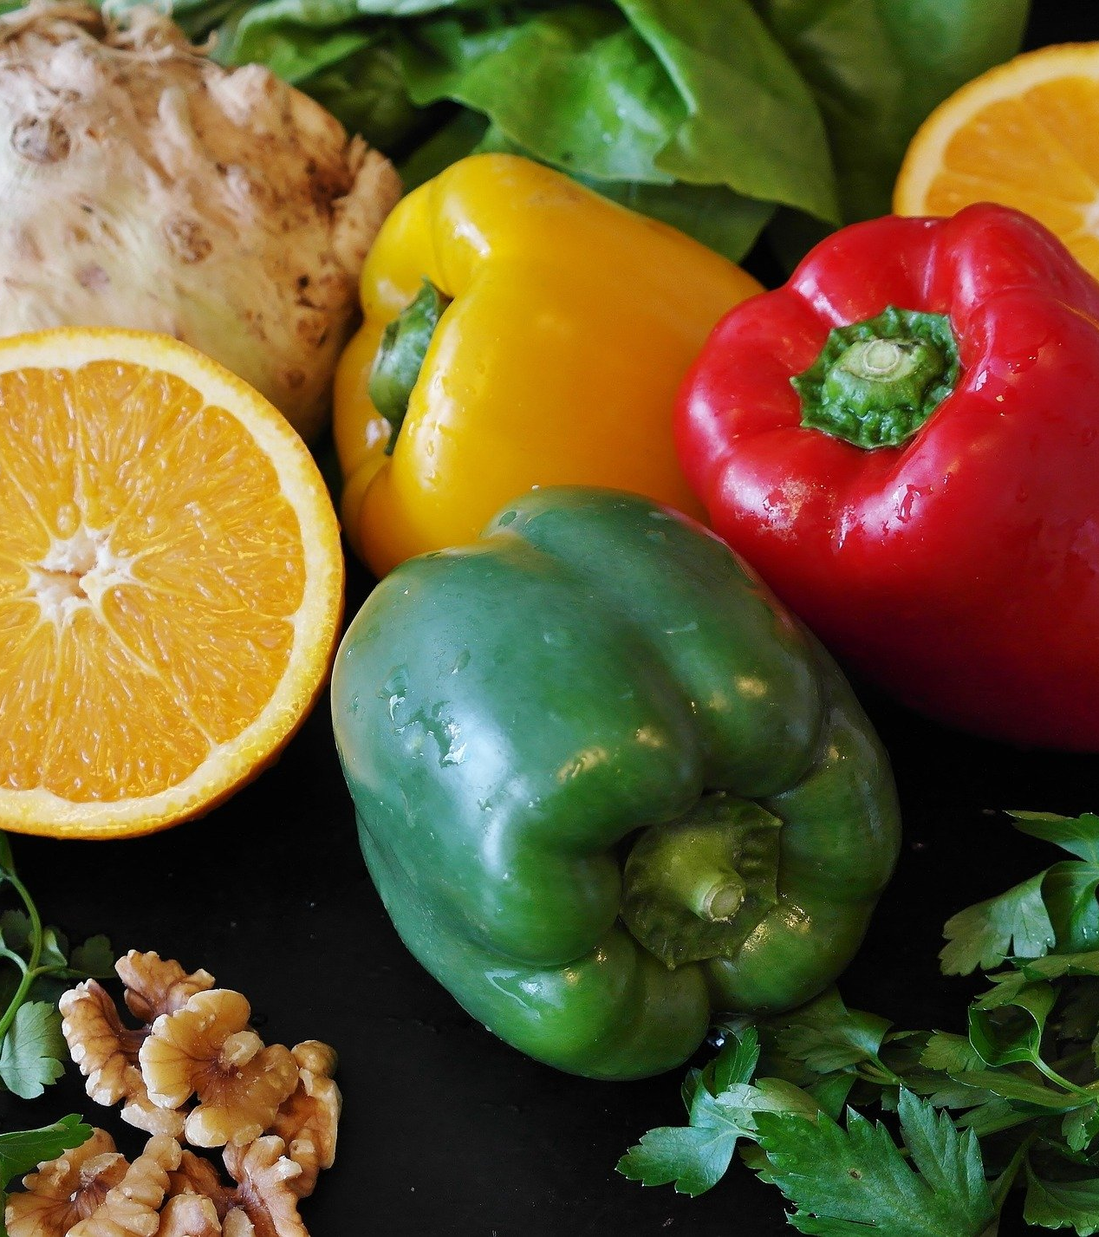
Food
Natural food preservative & antioxidant
Potential applications:
As food & beverage antioxidant with numerous health benefits
Functional food additive: improved glycemic control, energy boosting adaptogen)
Natural additive for food biodegradable packaging: superior antioxidant and antimicrobial food protection

Slide 17
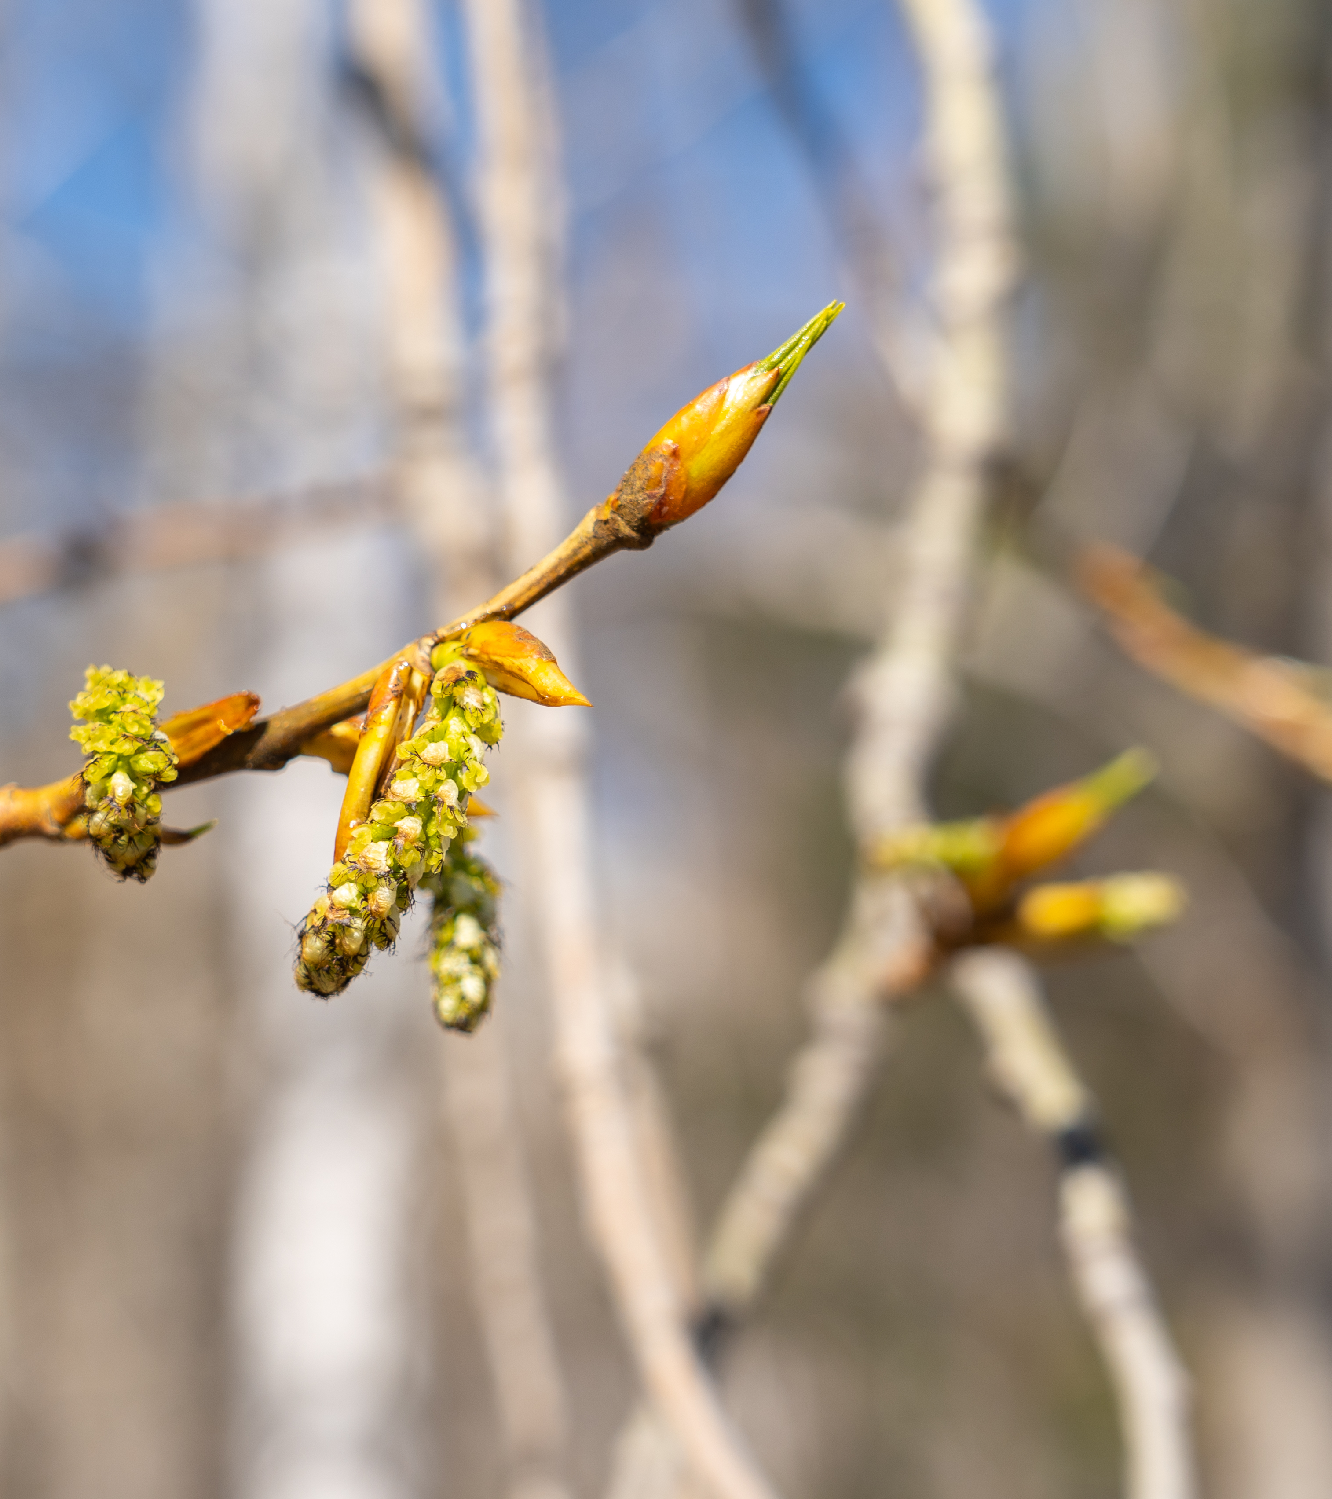
More than one extract
Standardized natural product with superb quality
Out technology enables us to extract bioactive compounds from natural sources without aggressive solvents and extensive energy consumption
Our production is environmentally friendly and sustainable
We invest in R&D of natural products from various sources

Slide 18
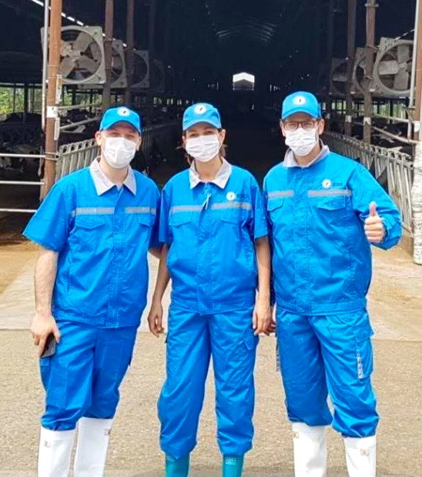
Contact us
We are working with strategic partners, investors and scientists all around the world!
jelena@apiotix.eu

